Slide 1

Chapter 6
Continual Development of the Salesforce: Sales Training

Slide 2
Learning Objectives
Understand the role of sales training in salesforce socialization/onboarding.
Explain the importance of sales training and the sales manager’s role in sales training.
Describe the sales training process as a series of six interrelated steps.
Discuss six methods for assessing sales training needs and identify typical sales training needs.

Slide 3
Learning Objectives
Name some typical objectives of sales training programs, and explain how setting objectives for sales training is beneficial to sales managers.
Identify the key issues in evaluating sales training alternatives.
Identify key ethical and legal issues in sales training.

Slide 4
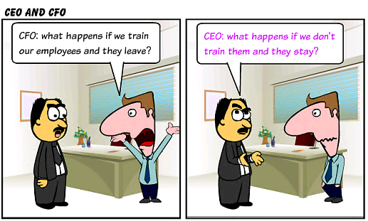

Slide 5

Role of Sales Training in Salesforce Socialization/Onboarding
Sales training helps socialize/onboard new hires, providing them with a positive:
Initiation to Task — The degree to which a sales trainee feels competent and accepted as a working partner.
Role Definition — An understanding of what tasks are to be performed, what the priorities of the tasks are, and how time should be allocated among the tasks.
What have your socialization /
onboarding experiences been
like? How did training play a role?
Notes:
Salesforce socialization/onboarding refers to the process by which sales-people acquire the knowledge, skills, and values essential to perform their jobs. Training plays a key role in this process.
A study of industrial salespeople found that when salespeople believe the company is taking certain actions to support the salesforce and reduce the difficulties associated with a sales position, they are more committed to and satisfied with the job.

Slide 6
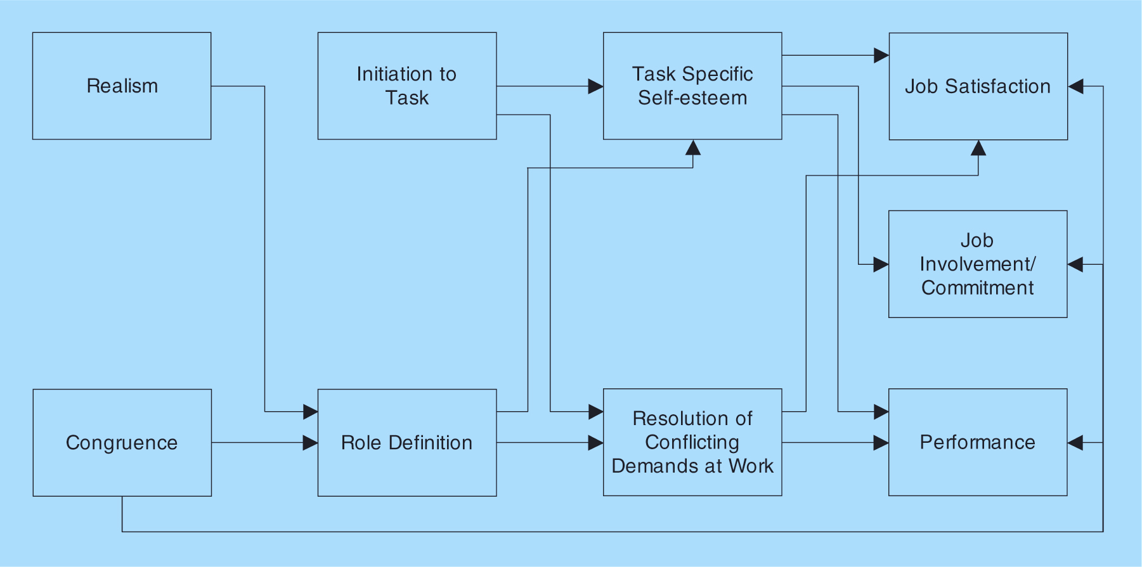
Proposed Model of Salesforce Socialization/Onboarding
Notes:
2

Slide 7
Sales Training as a Crucial Investment
Most organizations see a link between sales training and salesperson productivity.
U.S. companies spend billions annually on training.
The need for sales training is continual.
What makes a good teacher/trainer?
How do you learn best?
Notes:
2
A survey of 70,000 business decision makers found that 39 percent of purchasing decisions depend on the effectiveness of the sales rep, a larger portion than any other aspect, including price, product, or service.
Not only is training important in developing effective salespeople, but also in keeping them. One comprehensive study of salesforce effectiveness found inadequate sales training to be a driving force in turnover.

Slide 8

Sales Training as a Crucial Investment
Investment in Training
= Positive ROI
Notes:
2
According to a study conducted by the Association for Talent Development, organizations spend an average of approximately $2,000 per salesperson per year on sales training.

Slide 9
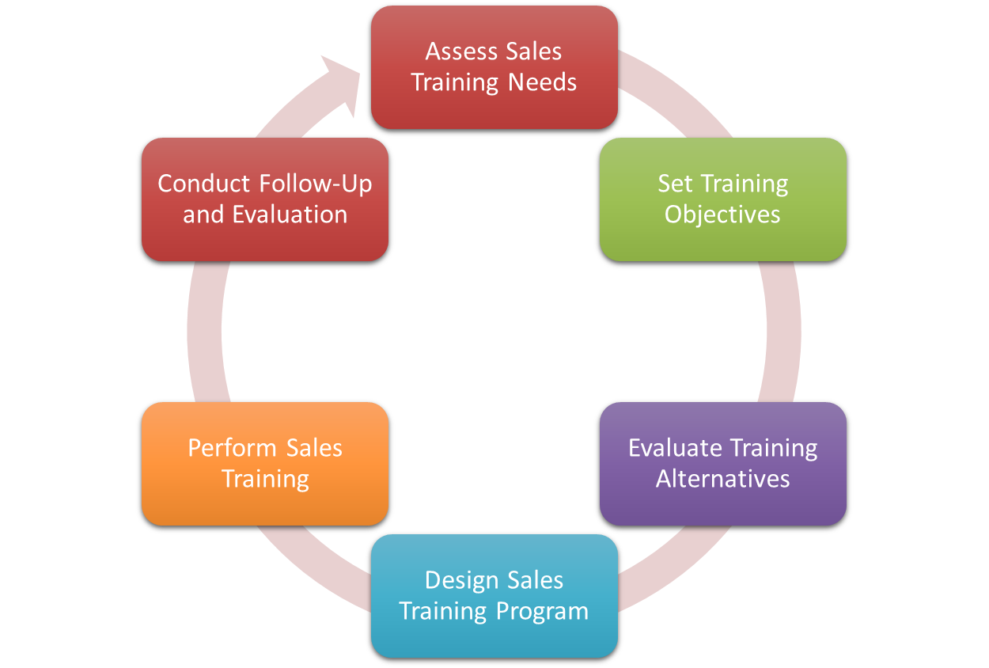
Managing the Sales Training Process
FEEDBACK →
Notes:
5
Companies view training as an important means for protecting their investments in their salesforces. Consequently, they spend a lot of time and money training salespeople. One study finds that to onboard new sales reps it takes three months of sales training to initially ready salespeople to interact with buyers, nine months for them to perform competently, and 15 months to become a top performer.

Slide 10
Assess Sales Training Needs
Determine the gap between where you are and where you need to be regarding sales knowledge, skills and competencies.
Notes:
Needs assessment requires that sales managers consider the training appropriate for both sales trainees and experienced salespeople.
What are the KNOWLEDGE, SKILLS, and ABILITIES needed to fulfill selling responsibilities, as well as organizational responsibilities.
Don’t wait to assess when there is a business decline, or decrease in morale to do this assessment! This should be an ongoing process.

Slide 11
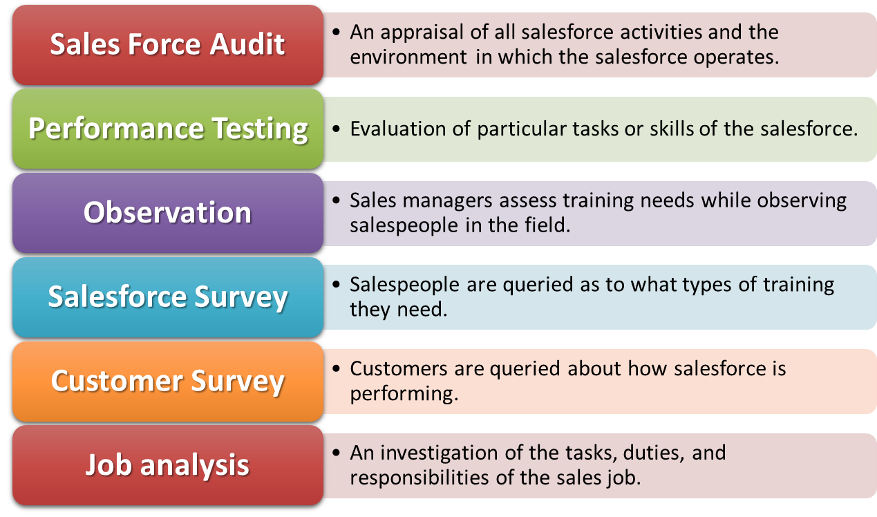
Assess Training Needs: Various Methods
Salesforce
Can also gauge competitiveness!
Notes:
5
Salesforce Audit:
To be effective, a salesforce audit should be conducted annually.
Is the training program adequate in light of objectives and resources?
Does the training program need revision?
Is an ongoing training program available for senior salespeople?
Does the training program positively contribute to the socialization/onboarding of sales trainees?

Slide 12

Typical Sales Training Needs
Sales Techniques: Salespeople have an ongoing need to learn “how to sell,” including questioning, listening, developing trust, managing relationships, and Emotional Intelligence (EI).
Product Knowledge: Salespeople must know their product’s benefits, applications, competitive strengths, and limitations.
Notes:
7

Slide 13
Typical Sales Training Needs
Customer Knowledge: Salespeople should know their customer needs, buying motives, buying procedures, and personalities.
Competitive Knowledge: Salespeople must know competitive offerings in terms of strengths and weaknesses.
Notes:
7

Slide 14
Typical Sales Training Needs
Time & Territory Management: Salespeople should learn to maximize work efficiency.
Sales technology : Salespeople should learn
to use various tools to boost
productivity.
Notes:
7

Slide 15

Relationship Building Characteristics Required of Salespeople
Customers want salespeople who:
personally manage the customer’s desired results.
fully understand the customer’s business.
act as a customer advocate.
are knowledgeable of product
applications.
are easily accessible.
solve the customer’s problems.
provide innovative responses
to customer needs.
Notes:
7

Slide 16
Sales Training Topics for Different Buyer Types
Buyer Type | Solution Type and Buying Environment | Sales Training Topic
Serve Me | Simple/Simple | How to facilitate the buyer to execute a purchase in-person or online.
Show Me | Complex/Simple | Deep understanding of solutions. How to assist the prospect in collecting and understanding information to evaluate and choose among alternatives.
Guide Me | Simple/Complex | Political skill to help the buyer navigate various internal stakeholders and/or acquire budget resources.
Enlighten Me | Complex/Complex | Consultative selling. Must have deep understanding of solutions and political skill to deal with multiple stakeholders in the buying process.

Slide 17

Set Training Objectives… SMAC
Increase sales or profits.
Create positive attitudes and improve salesforce morale.
Assist in salesforce socialization/onboarding.
Reduce role conflict and ambiguity.
Introduce new products, markets, and promotional programs.
Develop salespeople for future management positions.
Ensure awareness of ethical and legal responsibilities.
Notes:
8
Setting specific, measurable, and obtainable sales training objectives. Or “SMAC”– specific, measurable, achievable, compatible (to the main goal)

Slide 18
Set Training Objectives
Teach administrative procedures (e.g., expense accounts, call reports).
Ensure competence in the use of sales and sales support tools, such as CRM technology.
Minimize salesforce turnover rate.
Prepare new salespeople for assignment to a sales territory.
Improve teamwork and cooperative efforts.
Notes:
8
Objectives are interrelated.

Slide 19

Evaluate Training Alternatives
Consider cost!
Selecting Sales Trainers
Internal
External
Selecting Sales Training Locations
Decentralized (e.g., district or regional offices; Fastenal)
Centralized (e.g., corporate headquarters; Edward Jones)
Notes:
9
Consider cost!

Slide 20

Evaluate Training Alternatives
Selecting Sales Training Methods
Classroom/Conference Training
On-the-job Training (OJT)
Behavioral Simulations
Absorption Training
Selecting Sales Training Media
e-Learning (synchronous or asynchronous)
Videoconferencing
Flash Drives/Shared Drives
Paper-Based
Notes:
9
Consider cost!

Slide 21
An Ethical Dilemma
As a senior sales rep at the ABC Company, Roger is always more than willing to help out. Roger is a hard-working, high-performing Salesperson who is both well liked and well respected by his colleagues. So, when sales manager Carl asked Roger to mentor a new trainee, Keiko, as part of the company’s new sales mentorship program, he gladly stepped up to the challenge. Roger was asked to take Keiko, a recent college grad embarking on her first sales position, under his wings and show her the ropes. In doing so, Roger became very attracted to Keiko and wanted more than simply a “working” relationship. Keiko felt Roger was a nice guy, but she was not interested in a relationship. She began to feel uncomfortable with Roger’s advances but was afraid to complain, feeling that it might jeopardize her job. Moreover, Keiko felt that her sales manager Carl, being a male, would likely brush it off as Roger just being friendly. Keiko finally got up enough nerve to approach Carl with her concern. Upon hearing this, Carl was dismayed. Having known Roger for five years he believed this conduct to be completely out of character for Roger. In fact, he had his doubts about the truthfulness of Keiko’s accusation.
What should Carl do?
Tell Keiko that he will look into it but never do so, fearing it could upset Roger and possibly
lead to him leaving.
b. Visit with Roger to get his feedback on how the mentorship is going. If Carl determines that
Roger is making unwanted advances toward Keiko he should fire him for sexual harassment.
c. He should immediately assign Keiko a different mentor.
d. Do something else not listed here.
Notes:
DAY 1 ENDED HERE

Slide 22
An Ethical Dilemma
During a recent training session, national sales manager Chad was not happy with trainee Gina’s performance in a role-playing exercise. Upon conclusion of the exercise, Chad began to mock Gina’s role-playing behavior in front of the other trainees to illustrate how inadequate her performance was. Chad believed that his gesture would leave a lasting impression on the trainees and help make his point stick. Furthermore, he informed Gina and the trainees that if they performed like that on a sales call, they would be looking for a new job very soon.
How do you think that Chad should have handled this situation?
Chad should have asked another trainee to perform the role-play to show everyone the proper
way to perform.
Chad should have asked Gina to self-critique and then provided her with constructive criticism
for how to improve her performance.
Chad should have asked the trainees to provide feedback to Gina.
Do something else not mentioned here.

Slide 23
Training – Using Mobile
1. Limit content from two to ten minutes.
2. Offer customized content in a conversational style.
3. Offer information to make the user better, smarter or faster; only
include must know information.
4. Focus on areas of work that are done incorrectly or lack compliance.
5. Invite users to help design content to encourage participation.
6. Encourage users to look for the content, rather than push it on them.
7. Encourage users to diagnose their own training needs.
8. Make the content readily available so that users can quickly access it
when and where they need it.
9. Make the content interactive.
10. Incorporate images and videos; use animation, even for serious
content.
11. Provide clear instructions for how to navigate the content.
12. Capture learner feedback through short surveys.

Slide 24
Sales Management Exercise
Explain at least one idea for utilizing mobile technology in sales training.

Slide 25

Design the Sales Training Program
* Finalize the training program
* Schedule training sessions
* Make travel arrangements
* Book accommodations
Notes:
9

Slide 26

Perform Sales Training
The sales manager’s primary responsibility during sales training is to:
monitor progress of the trainees
ensure adequate presentation of the training topics
keep trainees motivated to learn
Notes:
9

Slide 27

Tips for Reinforcing Sales Training
Include refresher training throughout the year.
Facilitated reinforcement sessions should occur at
30/60/90-day intervals following the initial training.
Focus on reinforcing one or two key items at a time.
Provide short (five minutes or less) learning modules that are easily accessible. Try to integrate these into the customer relationship management program.
Provide coaching and mentoring to reinforce what was learned.
Use gamification to motivate and reinforce learned information. Periodic quizzes and games can help reinforce material.
Review learner progress periodically to determine if material is sticking.

Slide 28

Conduct Follow-Up and Evaluation
Effort should be made to measure the effectiveness of sales training.
A reasonable attempt must be made to assess whether current training expenditures are worthwhile and whether future modification is warranted.
Sales training should be reinforced.

Slide 29
Evaluating Training and Development Programs
Assess participant satisfaction with training
Determine principles, techniques and facts that were learned
Assess changes in job behavior resulting from training
Determine outcomes resulting from using what was learned
Did they like it?
Trainer
Content
Facilities
Etc.
Was there a transfer of knowledge and skills?
Pre-test
Post-test
Was learning put into action?
Observe in field
Ask customers
Tangible results?
Increased sales?
Higher cuotas?
New customers acquired?
Etc.

Slide 30
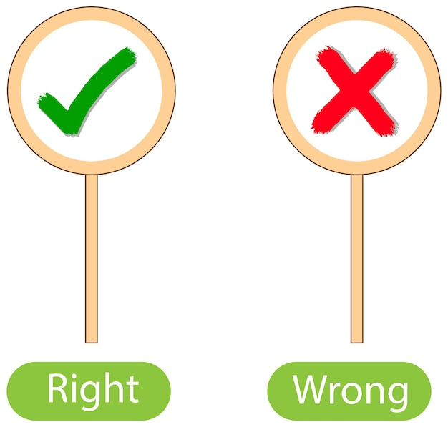
Ethical and Legal Issues
Training is Essential
(e.g. WSJ test)

Slide 31
Ethically Troubling Situations
Giving physical gifts such as free sales promotion prizes or “purchase-volume incentive bonuses” to a purchaser.
Providing free trips, free luncheons or dinners, or other free entertainment to a purchaser.
Using the firm’s economic power to obtain premium prices or other concessions from buyers.
Gaining information about competitors by asking purchasers. CONTEXT
Giving preferential treatment to purchasers whom higher levels of the firm’s own management prefer or recommend.
Attempting to reach and influence other departments directly rather than going through the purchasing department when such avoidance of the purchasing department increases the likelihood of a sale. CONTEXT

Slide 32
Legal Reminders for Salespeople
Use factual data.
Thoroughly educate customers.
Don’t overstep authority.
Be careful when communicating with competitors.
Don’t engage in “bait and switch.”
Don’t try to force the customer to buy only from your organization.
Don’t engage in discrimination.
Don’t tamper with a competitor’s product.
Do not disparage a competitor’s product.
Avoid promises that will be difficult or impossible to honor.

